Slide 1
Predicting crash severity

Slide 2
Introduction
Car crashes is the highest cause for accidental deaths and injuries.
The Severity of a car accident might be influenced by a number of parameters.
The ability to predict the severity could help to prevent future car crashes or reduce their severity.

Slide 3
Methods
Data cleaning: remove rows with missing data, remove columns with more than 40% missing data
Data standardization: use “standardScalar”
Data balancing: use “undersampling”
Data splitting: 66% train and 33% test
Model development: Logistic regression, Adaboost, Rnadom Forest
Model performance: Accuracy, F1-score, AUC.

Slide 4
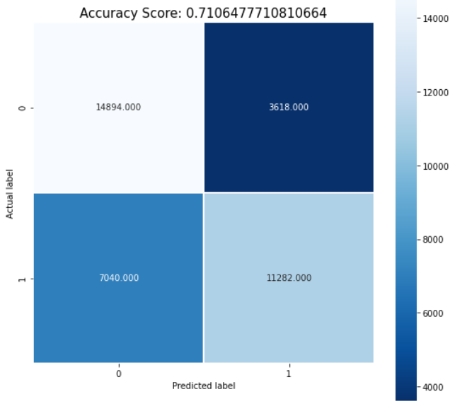
Results
Confusion matrix Logistic

Slide 5
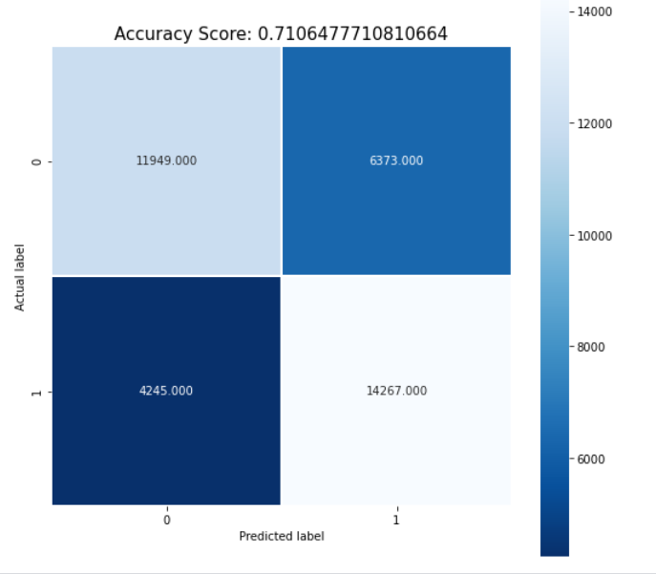
Results
Confusion matrix Adaboost

Slide 6
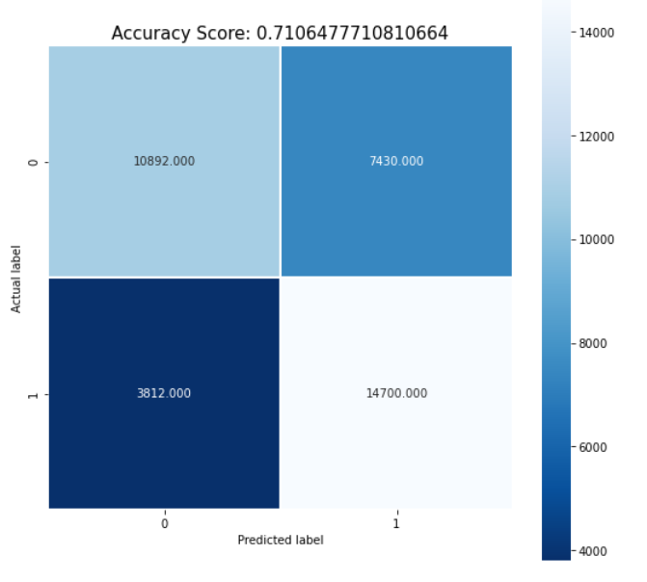
Results
Confusion matrix Random forest

Slide 7
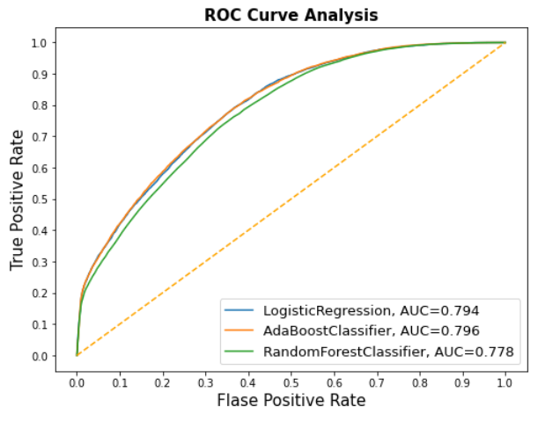
Results – ROC curves

Slide 8
Conclusions
In this report we build a model to predict the severity of an accident based on different variables including the weather, day of week, type of vehicle, location and more.
We see that different classifiers resulted in different performance.
The Adaboost method resulted in the best performance and in F1-score of 0.71.

